Slide 1

Angular
BECA Java
Verano 2018
Taller de Angular

Slide 2
Herre
juan.antonio.herrerias.berbel@everis.com

Slide 3
Taller de Angular
Typescript para javeros
Angular
Structural
Directives
Pipes & Methods
Splitting
Components
Mocks & Models

Slide 4
Taller de Angular
07
08
09
10
11
Property & Class Binding
Event
Binding
Two-way
Binding
Service
HTTP

Slide 5
02
Angular

Slide 6
What Is Angular?
Angular is a framework for dynamic web applications (SPA).
Provides a way to organize your HTML, JavaScript, and CSS to keep your front-end code clean.
Released in 2011.
Mainly maintained by Google with the help of the open-source community.
Back-end Server
Front-end

Slide 7


Reminder, TypeScript: Our Language of Choice
TypeScript is Microsoft’s extension of JavaScript that allows the use of all ES2016 features and adds powerful type checking and object-oriented features.
The Angular source is programmed with TypeScript.
main.js
main.ts

Slide 8
What Will This Course Cover?
Part 1
Our First Component
Part 2
Structural Directives, Pipes & Methods
Part 3
Code Organization & Data Models
Part 4
Data Binding
Part 5
Services & HTTP

Slide 9


Command Line Interface

Slide 10
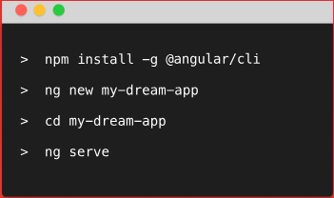

Angular CLI
The Angular CLI is a tool to initialize, develop, scaffold and maintain Angular applications.

Slide 11
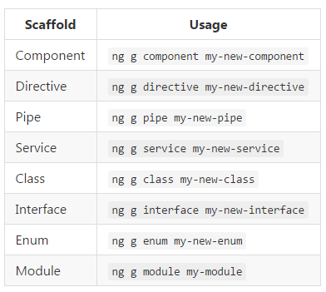
Angular CLI
Angular CLI help us with:
HTTP Server
Live-reload system
Testing tools
Deploying tools
To create new Angular components, services and pipes

Slide 12
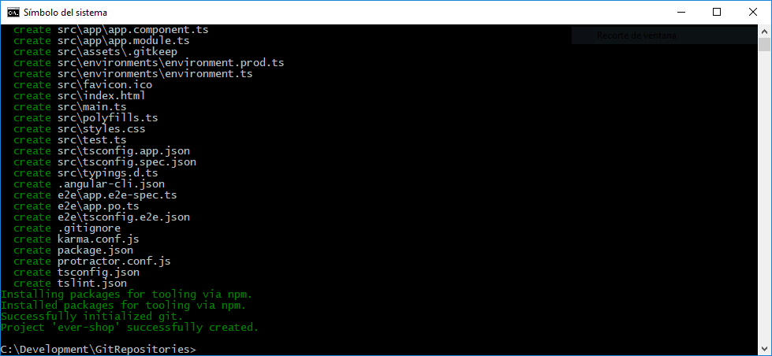
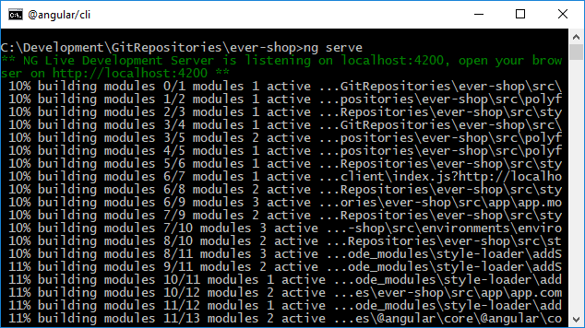
Our first Angular application
Generating and serving an Angular project via a development server
ng new ever-shop
cd ever-shop
ng serve

Slide 13
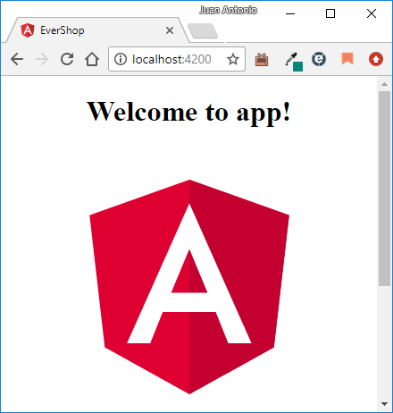
Our first Angular application
It works!

Slide 14
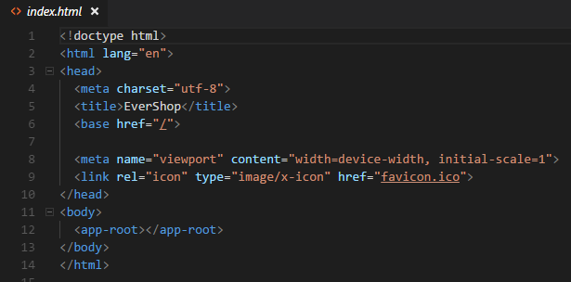
Our index
This is where our Angular application
will load.
This could be named anything,
even <evershop-app>

Slide 15
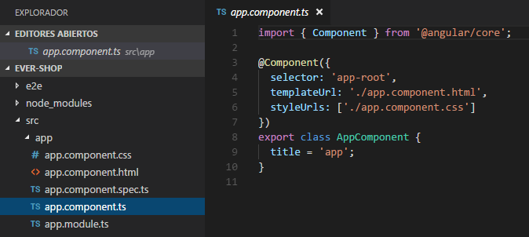
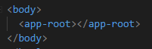
Our First Component
Angular library
Typescript Decorator
index.html
Components are the basic building blocks of Angular applications.
A component controls a portion of the screen.
@Component is used to apply our component decorator to our class.
selector is the HTML element where we want the component to load.
template is the content we want to load inside our selector (could be HTML code)

Slide 16
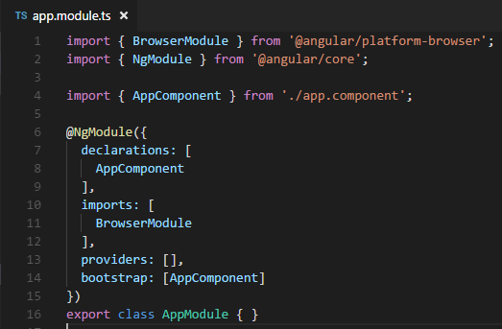
Declaring the Root Angular Module
Modules are how we organize our application in Angular. Every Angular application must have a “root module,” which we’ll need to launch it.
List of all components within the module
Loads required dependencies to launch
our app in the browser
Indicates our root component

Slide 17
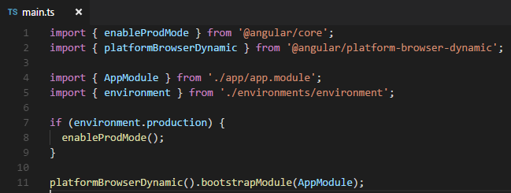
Declaring the Root Angular Module
Dependencies to render the application
Angular library that will render the website.
This will allow us to bootstrap, or launch, the app.

Slide 18
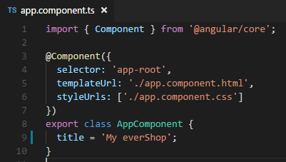
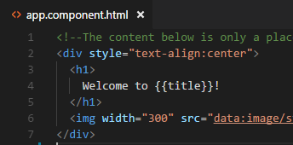
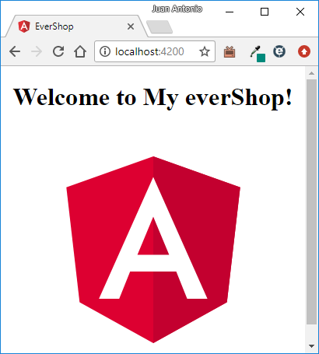
Sending Data Around
What if we have an object we want to print out onto the screen?
Inside a TypeScript class, we don’t use the var or let
keywords to declare class properties.
Though we do in regular methods.
Curly braces allow us to load in component
properties — this is called interpolation.

Slide 19
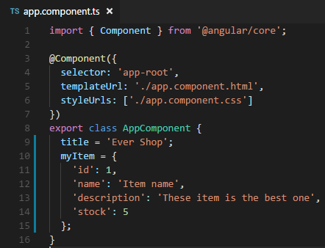
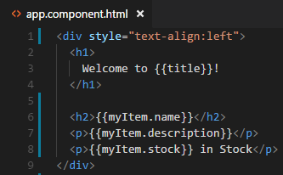
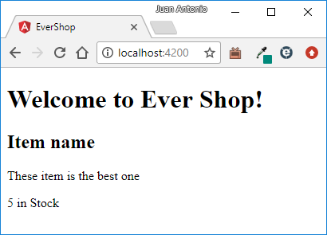
Loading an Object
How do we send a object properties from our component class into our HTML?

Slide 20
What’d We Learn?
Angular is a framework for dynamic web applications.
We are coding Angular using TypeScript, a language that transpiles into JavaScript.
‘NgModules group Angular code into blocks of functionality.
Components are the basic building blocks of any Angular application.
We use a custom HTML tag (aka, selector) to show where we want our component to load inside our HTML.
Decorators are what turn our plain TypeScript classes into Components.

Slide 21
03
Structural
Directives

Slide 22
Learning Angular Directives
A directive (within Angular) is how we add dynamic behavior to HTML.
What if we had more than one item?

Slide 23
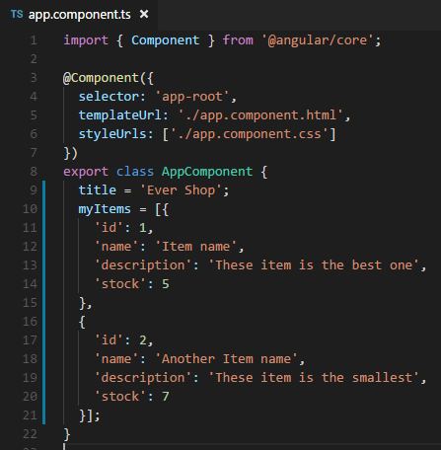
Learning Angular Directives
How do we loop through each of these?

Slide 24
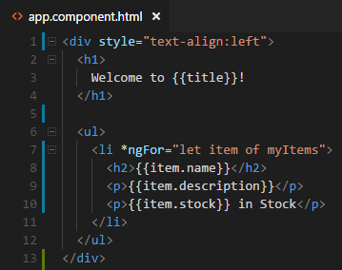
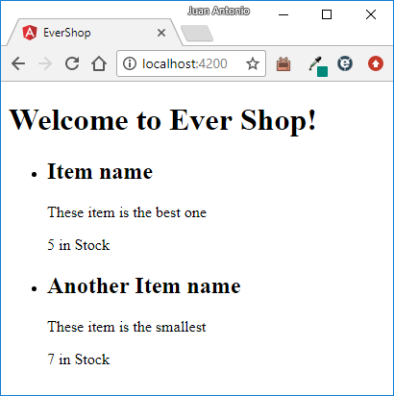
Learning Angular Directives
*ngFor is a structural directive.
item is a local variable.
myItems is the array to loop through
The loop is run twice: once for each myItem

Slide 25
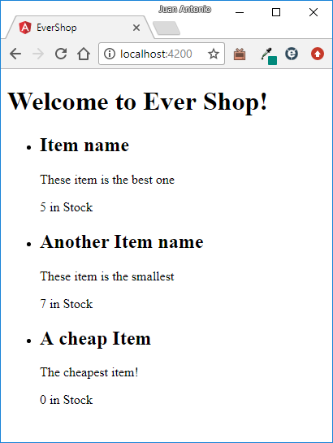
Learning Angular Directives
When there are none in stock, how can we display “Out of Stock”?
Should read “Out of Stock”

Slide 26
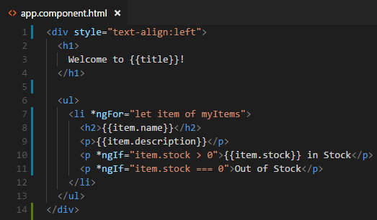
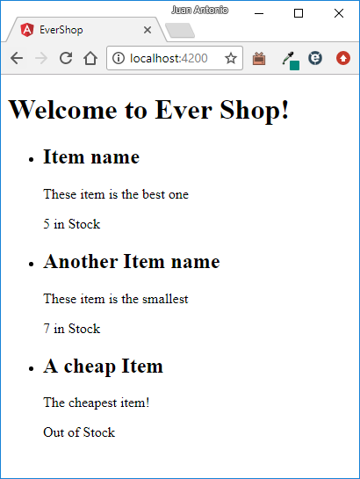
Learning Angular Directives
*ngIf is another structural directive. It allows us to evaluate conditionals.

Slide 27
What’d We Learn?
A directive (within Angular) is how we add dynamic behavior to HTML.
A component directive has a template.
A structural directive alters layout by adding, removing, or replacing HTML elements.
*ngFor Loops through an array.
*ngIf Shows content conditionally.
Angular documentation: https://angular.io/guide/structural-directives

Slide 28
04
Pipes &
Methods

Slide 29
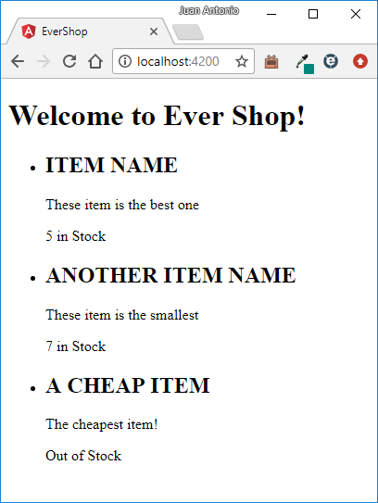
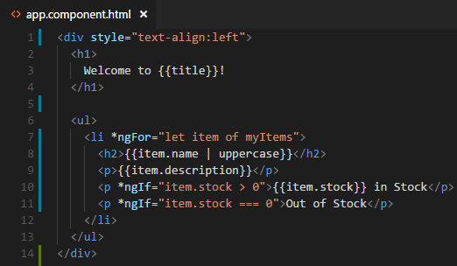
Using Pipes to Format Screen Data
A pipe takes in data as input and transforms it to a desired output.
How can we write out item name in capital letters?

Slide 30
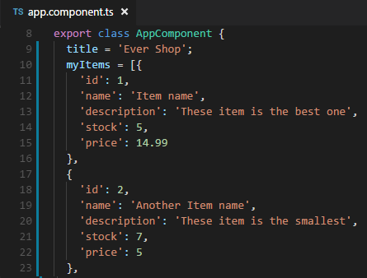
Adding a Price to Our Data
How do we format the price attribute properly?

Slide 31
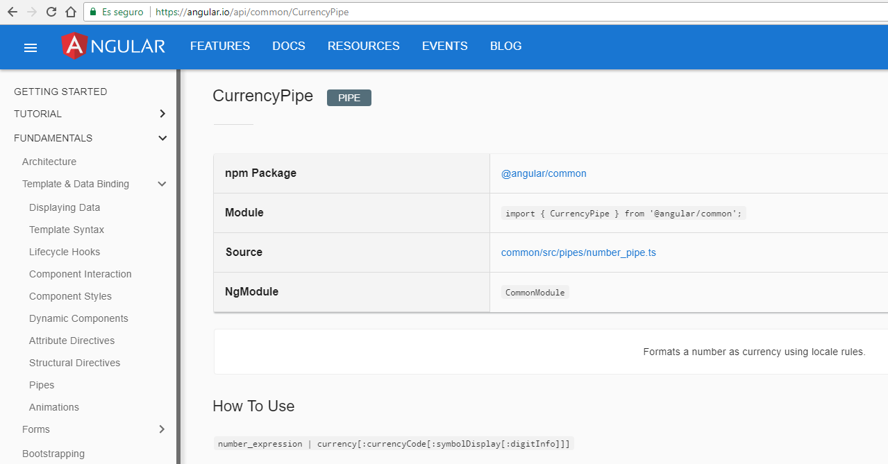
Looking for the right pipe to use
Angular documentation: https://angular.io/guide/pipes

Slide 32
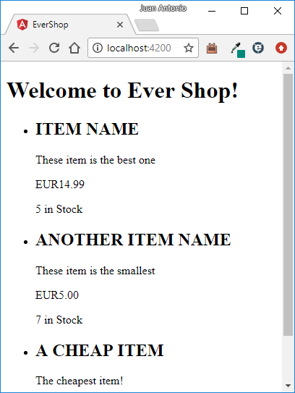
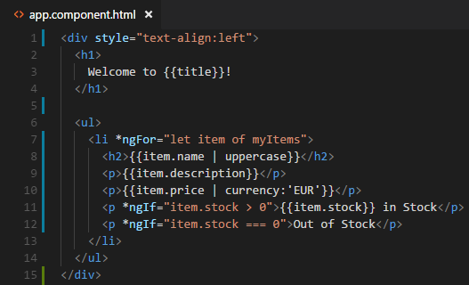
Using the Currency Pipe With One Parameter
By default, currency pipe uses ISO 4217 currency code, such as USD for dollar or EUR for the euro.
But we want the EUR symbol — how do we do that?

Slide 33
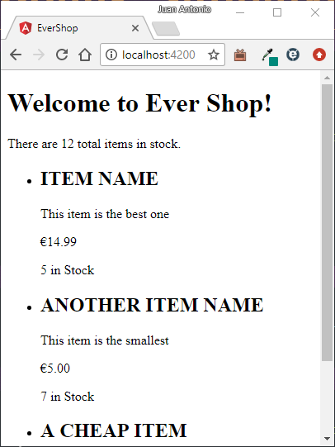
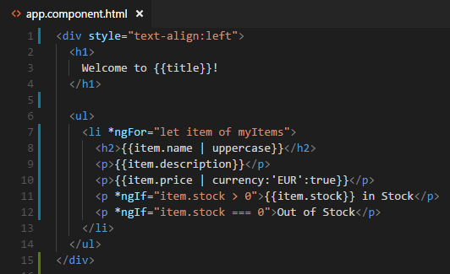
Using the Currency Pipe With Two Parameters
The second parameter is a boolean indicating if we should use the currency symbol.

Slide 34
Additional Pipes to Use
lowercase
Well, lowercase...
date
Formats dates how you like them.
number
Formats numbers.
decimal
Formats decimals.
replace
Creates a new string, replacing speciﬁed characters.
slice
Creates a new list or string containing a subset of the elements.
json
Transforms any input to a JSON-formatted string.
custom pipe
You can write your own custom pipes.
https://angular.io/guide/pipes#custom-pipes

Slide 35
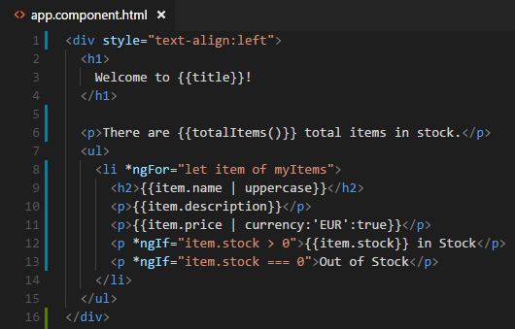
Listing the Number of Items in Stock
How could we display the total number of items in stock?
We’ll add new code to our HTML template and print the result of a method we’re about to deﬁne.
We deﬁne this method inside of our component class.

Slide 36
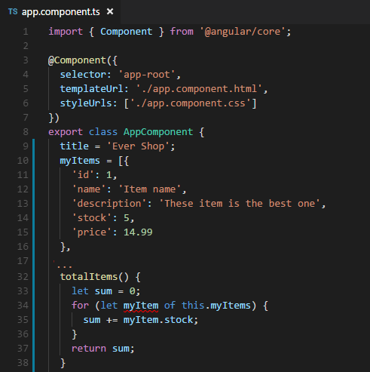
Implementing the Sum of my Items
Let’s use an ES2015 for of loop, like in our template.

Slide 37
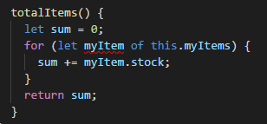
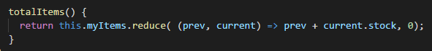
Implementing the Sum of my Items
It looks really awful… so….. How could we simplify this code using fat arrow (arrow function) ?

Slide 38
05
Splitting to Two Components

Slide 39
Splitting Things Into Pieces
We’ve been developing Angular in one single ﬁle: app.component.ts. This isn’t going to scale, so let’s split things up into pieces and get organized.
app.component.ts
app.component.ts
item-list.component.ts
This component contains our page header.
This contains our list of item.

Slide 40
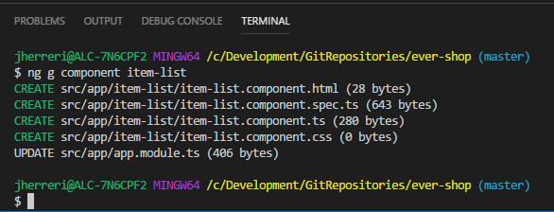
Create Our New Component
We need to create a item-list.component.ts
Let’s use Angular-CLI again!
ng g component item-list

Slide 41
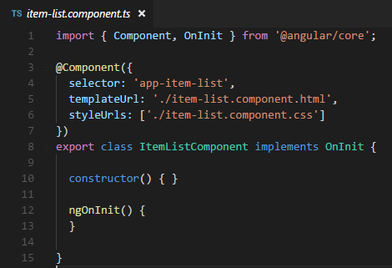
Splitting Out Our Item List Component
Moving code from app.component.ts to item-list.component.ts and code from app.component.html to item-list.component.html
New Selector

Slide 42
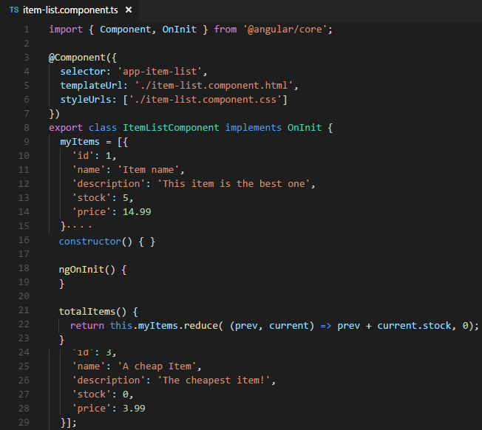
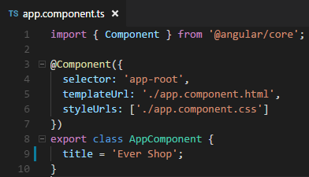
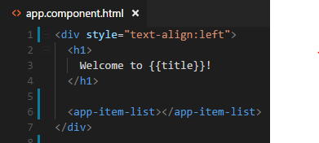
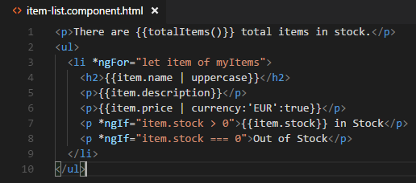
Splitting Out Our Item List Component
Components are meant to be reusable, so we could
use them in diﬀerent parts of our application.

Slide 43
06
Mocks & Models

Slide 44
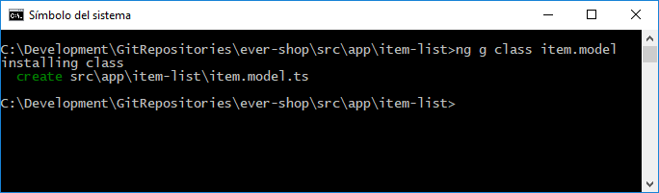
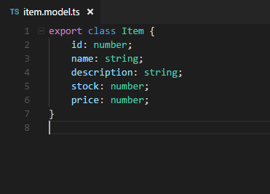
Getting More Object Oriented
TypeScript gives us the ability to be more object oriented with our data, so let’s create a model.
ng g class item.model
Thanks to TypeScript we’re declaring what type each of our properties are.

Slide 45
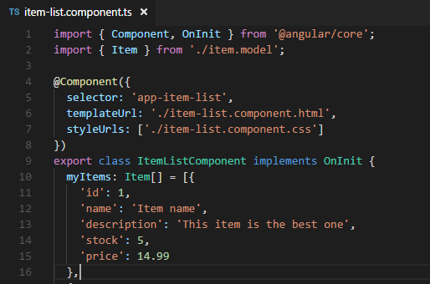
Import the Model & Deﬁne Type
Import the Item Model
Tells TypeScript to treat this like an array of Items

Slide 46
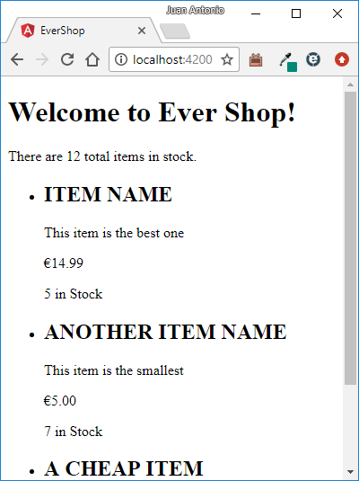
Nothing Else Needs to Change

Slide 47
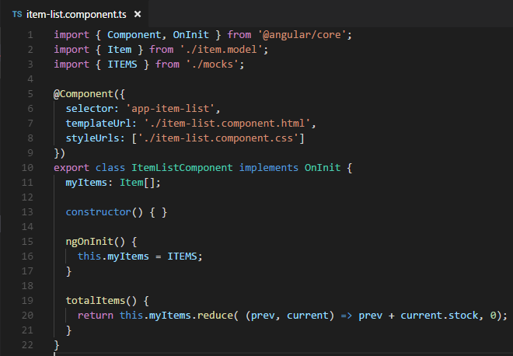
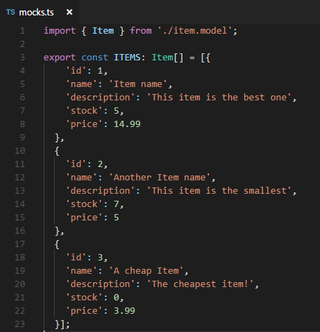
Cleaning Up Our Mock Data
Eventually we want to call out to a web service (API) to get the item list, so it’s a good practice to move our mock (fake) data out into its own ﬁle.
ngOnInit is invoked after the component is constructed and is the best place to initialize property values.
We could have initialized in the constructor, but that’d be harder to test.
Notice we use const instead of let —that makes sure items can't be reassigned.

Slide 48
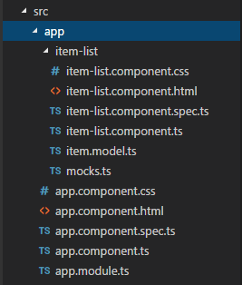
It still works after refactoring
We didn’t add any more functionality, but our code became a lot easier to maintain and scale.
It’s a good practice to keep your mock data separate from your model and your components, in its own ﬁle.

Slide 49
07
Property & Class Binding

Slide 50
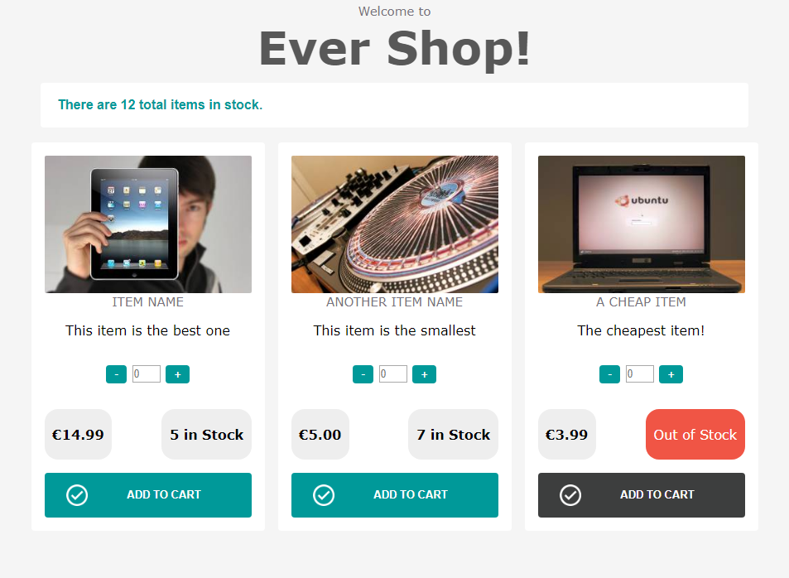
Adding some design
Not having to work with more complex HTML has been nice as we’ve learned Angular, but now we’re going to implement a better design.
We’ll be adding the images and item quantity after styling our code.

Slide 51
Moving the CSS to right files
We can add global styles to styles.css file and the other css code to the specific css component file
styles.css
Global styles
item-list.component.css
Specific CSS code for the component
HTML may be changed too if we use some specific CSS class

Slide 52
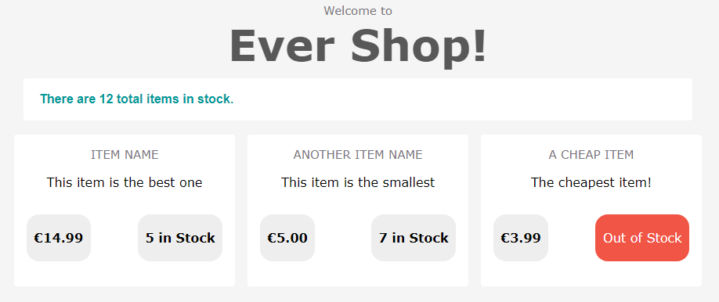
Our Current App With Styles
Better design, but how we bring images in?

Slide 53
The Ways Data Can Flow
When using a web framework like Angular that abstracts your code from HTML, there are a few diﬀerent ways that data can ﬂow.
JavaScript to HTML
Like we’ve been doing with properties from our components
HTML to JavaScript
Like a mouse click, hover or key press
Both Ways
Like a text box, that should stay in sync

Slide 54
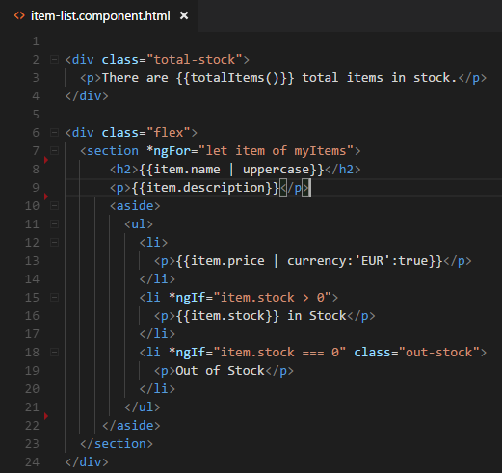
JavaScript to HTML
In our application thus far, we’ve been sending all sorts of data from our components into our HTML using interpolation.
So, how would we add an image tag with a dynamic image?

Slide 55


Adding Images to Our Model
We will add this property to our model, add new ﬁles, and add them to our mock data.

Slide 56


Adding an Image to Our Template
We could try adding our image onto our page using interpolation.
This would work just ﬁne.
However, there’s an alternative syntax we can use when we want to set DOM element property values.

Slide 57

Introducing Property Binding
Property binding allows us to glue component properties to DOM element properties.
Notice the square brackets and no curly braces!
The square brackets tell Angular to set this DOM element property to our component property.
And if the component property changes, update this part of the DOM.

Slide 58
Additional Property Binding Examples
All we need to do is add brackets and specify a component property.
<div [hidden]="!user.isAdmin">secret</div>
<button [disabled] ="isDisabled">Add to Cart</button>
<img [alt] ="image.description">

Slide 59


Adding a Selected Item
If a item is marked as “selected,” we want to add a specific class to it.
How do we add functionality to sometimes add this selected class?

Slide 60


Adding a Featured Property & Data
We need to add a new property to our item model and add mock data for it.
Next, we need to conditionally add a class if this property is true.

Slide 61

Using a Class Property Binding
There’s a unique syntax for binding to a class.
If item.selected is true, then the selected class is added. If item.selected is false, then the selected class is removed.

Slide 62
How Not to Use Class Binding
You might be tempted to bind directly to the class element property:
No!!!!
This will overwrite all classes.
<div [class]=“property">
<button [class.name] =“property">
This will only add/remove the speciﬁc class.

Slide 63
What’d We Learn?
Property binding allows us to bind component properties to any DOM element properties.
Any update to the component property value will update the DOM property, but not vice versa — that’s why it’s “one-way binding.”
Class binding allows us to specify a CSS class to add to a DOM element if a component property is true.

Slide 64
08
Event Binding

Slide 65
Types of Data Binding
JavaScript to HTML
Property Binding
Class Binding
HTML to JavaScript
Event Binding
Like a mouse click, hover or key press

Slide 66

Adding Events to Our Page
Click events

Slide 67


Adding a Quantity Property & Data
We need to add a new property to our item model and add mock data for it.

Slide 68

Adding a Simple Button
item-list.component.ts
. . . .
export class ItemListComponent implements OnInit {
. . . .
upQuantity() {
console.log('You called upQuantity');
}
}
To capture an event from our template, we wrap the name of the event we want to listen to in parentheses and specify the method to call.
item-list.component.html
<div class="panel-amount">
<button class="btn-amount" (click)="upQuantity()">+</button>
</div>

Slide 69

Making It Actually Work
Now let’s use the item.quantity that we have on each item.
item-list.component.html
. . . .
<div class="panel-amount">
<input type="number" maxlength="2" placeholder="0" class="amount" [value]="item.quantity"/>
<button class="btn-amount" (click)="upQuantity(item)">+</button>
</div>
. . . .
We need to send the current item
to our component.
But we need to make changes in our component in order to add only when we have in stock.

Slide 70


Limited Incrementing
We shouldn’t be able to add more quantity than we have in stock.
item-list.component.ts
. . . .
export class ItemListComponent implements OnInit {
. . . .
upQuantity(item: Item) {
if (item.stock > 0) {
item.quantity++;
item.stock--;
}
}
}
Increment quantity
Decrement stock

Slide 71


Adding a Decrease Button
item-list.component.ts
. . . .
export class ItemListComponent implements OnInit {
. . . .
downQuantity(item: Item) {
if (item.quantity !== 0) {
item.quantity--;
}
}
}
We decrease the quantity but not below zero.
item-list.component.html
. . . .
<div class="panel-amount">
<button class="btn-amount" (click)="downQuantity(item)">-</button>
<input type="number" maxlength="2" placeholder="0" class="amount" [value]="item.quantity"/>
<button class="btn-amount" (click)="upQuantity(item)">+</button>
</div>
. . . .

Slide 72
Other Events to Listen For
Any standard DOM event can be listened for by wrapping it in parentheses and removing the “on” at the beginning of the word.
<div (mouseover)="call()">
<input (blur)="call()">
<input (focus)="call()">
<input type="text" (keydown)="call()">
<form (submit)="call()">

Slide 73
Getting Additional Event Data
Sometimes you need additional event data, like which key is pressed or where the mouse is on the screen. This is what the Angular event object is for.
<input type="text" (keydown)="showKey($event)">
showKey(event) {
alert(event.keyCode);
}
We can send the $event object into our methods.
<h2 (mouseover)="getCoord($event)">Hover Me</h2>
getCoord(event) {
console.log(event.clientX + ', ' + event.clientY);
}
We could also call event.preventDefault(); to prevent a clicked link from being followed or a form from being submitted.

Slide 74
What’d We Learn?
Event binding allows us to listen to any DOM event and call a component method when it’s triggered.
To listen to any event, we need to remove the “on” in front of the word, wrap it in parentheses, and specify a component method to call.
If we need to access the event object, we can pass it in to our component method with $event.

Slide 75
09
Two-way
Binding

Slide 76
Types of Data Binding
JavaScript to HTML
Property Binding
Class Binding
HTML to JavaScript
Event Binding
Both Ways
Like a text box, that should stay in sync

Slide 77
Checking Out our Input Field Using Property Binding
item-list.component.html
. . . .
<div class="panel-amount">
<button class="btn-amount" (click)="downQuantity(item)">-</button>
<input type="number" maxlength="2" placeholder="0" class="amount" [value]="item.quantity"/>
<button class="btn-amount" (click)="upQuantity(item)">+</button>
</div>
. . . .
The ﬁrst thing we tried was to use property binding to bind the value to the quantity.
This gives us our quantity value in our input box, but only in one direction: from our component property to our input value.

Slide 78
Using Event Binding
We need to listen for the input event on our input box.
item-list.component.html
. . . .
<div class="panel-amount">
<button class="btn-amount" (click)="downQuantity(item)">-</button>
<input type="number" maxlength="2" placeholder="0" class="amount" [value]="item.quantity“
(input)="item.quantity = $event.target.value"/>
<button class="btn-amount" (click)="upQuantity(item)">+</button>
</div>
. . . .
Now the information is flowing two ways.
But it’s really awful and there’s another way, the “Angular way”

Slide 79

Importing the FormsModule
Let’s import the FormsModule to get additional forms functionality into our codebase.
Import FormsModule from Angular core
Make form-specific functionality available to our whole app

Slide 80
Using ngModel
ngModel allows us to have one command to express two-way data binding.
item-list.component.html
. . . .
<div class="panel-amount">
<button class="btn-amount" (click)="downQuantity(item)">-</button>
<input type="number" maxlength="2" placeholder="0" class="amount“ [(ngModel))]="item.quantity“/>
<button class="btn-amount" (click)="upQuantity(item)">+</button>
</div>
. . . .
Notice that we’re using both brackets(input) and parentheses(output). [()]
This syntax is sometimes called “banana in a box”

Slide 81
The ngModel Syntax
When we use the ngModel syntax, we can only set it equal to a data bound property.
[(ngModel))]=“<must be data property>“
We will mostly use this for form fields.
[(ngModel))]=“user.age“
[(ngModel))]=“firstName“
These are component properties uses in the right way
[(ngModel))]=“fullName()“
This will error out

Slide 82
What’d We Learn?
The [(ngModel)] syntax allows us to specify a component property that will use two-way binding.
Two-way binding means that if the component property is modiﬁed inside the component ( JavaScript) or inside our web page (HTML), it will stay in sync.

Slide 83
10
Service

Slide 84
Revisiting Our Mock Data
We are loading our item-list by importing our mock ﬁle, but this isn’t the best solution for working with data.

Slide 85
Why This Isn’t the Best Method
We’d need to import the mocks on every ﬁle that needs the data. If the way we access this data changes, we’d have to change it everywhere.
It’s not easy to switch between real and mock data.
This sort of data loading is best left to service classes.

Slide 86
Introducing Services
Services are used to organize and share code across your app, and they’re usually where we create our data access methods.
item-list.component.ts
Asks the service for data
item-list.service.ts
Fetches the appropriate data
mock.ts
First, let’s create the simplest service, and then we’ll learn something called dependency injection to make it even more powerful.

Slide 87


Writing Our First Service
We’ve decoupled our data.
But ……………….
Classes using this service must know how to create a ItemListService.
We’ll be creating a new ItemListService every time we need to fetch items.
It’ll be harder to switch between a mock service and a real one.

Slide 88
Introducing Dependency Injection
When you run an Angular application, it creates a dependency injector. An injector is in charge of knowing how to create and send things.
Dependency
Injector
Create the instance and send it to the component
Asks for ItemListService instance
item-list.component.ts
item-list.service.ts
The injector knows how to inject our dependencies.
Create (if needed) and send classes we depend on.

Slide 89
Re-injecting Dependencies
If the injector already created a service, we can have it resend the same service.
Dependency
Injector
It already created one so it sends the same instance
Asks for ItemListService instance too
item-admin.component.ts
item-list.service.ts
item-list.component.ts

Slide 90
How Does an Injector Know What It Can Inject?
We must tell the injector what it can inject by registering “providers” with it.
Dependency
Injector
The Providers
item-list.service.ts
item.service.ts
api.service.ts
There are three steps to make this all work with ItemListService:
Add the injectable decorator to ItemListService.
Let our Dependency Injector know about our service by naming it as a provider.
Inject the dependency into our item-list.component.ts.

Slide 91

Step 1: Add the Injectable Decorator
We need to turn our service into something that can be safely used by our dependency injector.
The parentheses!!!

Slide 92

Step 2: Let Our Injector Know About the Service
We want all our subcomponents to have access to ItemListService. To do this, we register it as a provider at the AppModule module.
Now all subcomponents can ask for (inject) our ItemListService when they need it, and an instance of ItemListService will either be delivered if it exists, or it will be created and delivered.

Slide 93

Step 3: Injecting the Dependency
This is what identiﬁes that the ItemListService should be injected into this component.
We don’t need to create the instance, Dependency Injector makes it for us
Now our app is more scalable and testable.
Scalable because our dependencies aren’t strongly tied to our classes.
Testable because it’d be easy to mock services when we test the component.

Slide 94

Our App Still Works

Slide 95
What’d We Learn?
Services are used to organize and share code across your app, and they’re usually where you create your data access methods.
We use dependency injection to create and send services to the classes that need them.
We give our dependency injector providers so that it knows what classes it can create and send for us.
We ask for dependencies by specifying them in our class constructor.

Slide 96
11
HttpClient

Slide 97
Let’s Use the Internet!
Up until now, we’ve been seeding our items with mock data. How might we fetch this from the internet instead?
item-list.component.ts
Asks the service for data
item-list.service.ts
Fetches the appropriate data
Internet (JSON data)

Slide 98
Welcome to the Real World
When a user visits our web page, the Angular app loads ﬁrst in our browser, and then it fetches the needed data.
Browser
Server
Initial Browser Request
HTML / JavaScript / CSS Response
Angular
Loads
Data Request (item list)
JSON

Slide 99
Step 1: Creating a JSON File
item.json
Get a full fake REST API with JSON Server.
Ensure our application includes the libraries it needs to do Http calls.
Tell our injector about the http provider.
Inject the http dependency into our service and make the http get request.
Listen for data returned by this request.
app.module.ts
app.module.ts
item-list.service.ts
Item-list.component.ts

Slide 100

Step 1: Running JSON Server
We have our awesome app and only want to work on its front end like we are making right now. But we need to create an API for it first because without it, we wouldn’t be able to proceed with the app.
json-server is an open source mock API tool that solves this problem for us. It allows usto create an API with a database within minutes with bare minimum setup. Creating mock CRUD APIs with JSON-server requires zero-coding, we just need to write a configuration file for it.
Github Project: https://github.com/typicode/json-server
Install json-server globally using NPM:
npm install -g json-server
We need to create a JSON file in which we'll store item data for JSON Server to use (item-list-mock.json):
All we have to do now is start up JSON Server, pointing it to the item-list-mock.json file we just created, like so:
json-server item-list-mock.json

Slide 101



Step 1: Running JSON Server
Head over to localhost:3000 and you'll see the default JSON Server page:
The great part is that you can make GET, POST, PUT, PATCH, and DELETE requests to the server for testing your prototype, straight out-of-the-box.

Slide 102
Step 2: Including the HTTP and RxJS Libraries
The HTTP library provides the get call we will use to call across the internet.
The RxJS library stands for Reactive Extensions and provides some advance tooling for our http calls.
UOOOOO!!!

Slide 103

Step 3: Telling Our Injector It Can Inject HTTP
To inject the HttpClient service we need to import the HttpClientModule.
// import HttpClientModule after BrowserModule.
Now we’ll be able to inject the HTTP library when we need it.

Slide 104

Step 4: Injecting HTTP & Using It
Now let’s inject http and call out to the internet.
Injecting HTTP as a dependency and using RxJS Observables to call our fake API

Slide 105

Step 5: Subscribing to the Stream
Since our service now returns an observable object, we need to subscribe to that data stream and tell our component what to do when our data arrives.
When items arrive on our data stream, set it equal to our local items array.

Slide 106


Checking for Undeﬁned items
If we open our browser, Chrome for example, and Chrome DevTools (F12) we can check in Network tab that now, there is at least one http call made by our app.
What happen if we open Console Tab? Is there any error? Why?
Notes:
TypeError: Cannot read property ‘reduce' of undefined at ItemListComponent.totalItems
When our page initially loads, we haven’t yet fetched any data, so our item array is undeﬁned

Slide 107

All Working — Now Over the Internet!
Notes:
TypeError: Cannot read property ‘reduce' of undefined at ItemListComponent.totalItems
When our page initially loads, we haven’t yet fetched any data, so our item array is undeﬁned

Slide 108




Other HTTP calls
POST

Slide 109


Other HTTP calls
PUT

Slide 110


Other HTTP calls
DELETE

Slide 111
Adding functionality to our shop
We are going to add new features to our shop.
You can edit the item description. When you click over your description, the field changes into editable input and after changing the text you have to update the information.
1. Add the service to item-list.service.ts
2. Add method to item-list.component.ts to call the update method in item-list.service.ts
3. Change your template to add the functionality for item description. After submitting the change you have to call the method created in item-list.component.ts
Notes:
TypeError: Cannot read property ‘reduce' of undefined at ItemListComponent.totalItems
When our page initially loads, we haven’t yet fetched any data, so our item array is undeﬁned

Slide 112





Adding functionality to our shop
Click!
PUT
Notes:
TypeError: Cannot read property ‘reduce' of undefined at ItemListComponent.totalItems
When our page initially loads, we haven’t yet fetched any data, so our item array is undeﬁned

Slide 113
What’d We Learn?
Angular apps usually load data using service classes after the Angular app is initialized and running.
We can use the HTTP library through dependency injection.
Our http calls return an observable, not a promise, which behaves more like an array.
Notes:
TypeError: Cannot read property ‘reduce' of undefined at ItemListComponent.totalItems
When our page initially loads, we haven’t yet fetched any data, so our item array is undeﬁned

Slide 114
One
More
Thing
X

Slide 115
Basic
Routing
X

Slide 116
Basic Routing
We use routing to separate different parts of our app, generally (but not always) by using the URL to denote our location.
Angular’s router is super easy to use
The idea is that every URL (/login, /dashboard) is mapped to a component.
There are three main components that we use to configure routing in Angular:
Routes describes our application’s routes
RouterOutlet is a “placeholder” component that gets expanded to each route’s content
RouterLink is used to link to routes

Slide 117
Routes Component
Routes is an object that we use on our application component that describes the routes we want to use. For instance, we could write our routes like this:
const routes: Routes = [
{ path: '', redirectTo: 'home', pathMatch: 'full' },
{ path: 'home', component: HomeComponent },
{ path: 'login', component: LoginComponent },
{ path: 'dashboard', component: DashboardComponent }
];
We can redirect using the
‘redirectTo’ option
We use ‘path’ to specify the URL.
We specify the component we want to route to.

Slide 118

Routes Component: providing our Router
To install our router into our app we use the RouterModule.forRoot() function in the imports key of our NgModule:

Slide 119

RouterOutlet Component
The RouterOutlet directive tells our router where to render the content in the view.
Whenever we switch routes, our content will be rendered in place of the router-outlet tag.
If we were switching to the /login page, the content rendered by the LoginComponent would be placed there.

Slide 120

RouterLink Component
We use the RouterLink directive to navigate between routes.
This indicates which route to navigate to when we click the element.

Slide 121

Adding cart and routing
Notes:
Aquí explicamos que así es como tenemos nuestra aplicación pero todavía creemos que podemos separarla en más componentes. ¿Qué componente añadiríamos?

Slide 122


Adding cart and routing
Click!
Notes:
1. Tendremos que añadir

Slide 123
Adding cart and routing
Click!
Create new Component -> ng g component order
Add a new model (Cart) where we can save the items selected.
Change the component to manage an Array<Item> inside our Cart. Every time we click to “Add to Cart” button we have to add an Item to our Array.
Change the template to show the number of items added to our Cart
When we click to cart icon or whetever, we change the route navigating to OrderComponent (blank template…..at the moment).
Notes:
1. Tendremos que añadir

Slide 124



Adding Cart
Routes Configuration!
Router Outlet
Router Link
Notes:
1. Tendremos que añadir

Slide 125
One
More
Thing
More
X

Slide 126
Share Data
Between
Components
X

Slide 127


What we need?
We need to pass information when we go to a new route. But we don’t use any HTML like [tag] which interacts between HTML and Component. HOW?????

Slide 128

Shared Services

Slide 129

Using Shared Services

Slide 130

Adding our order component (More components!)

Slide 131
Adding our order component (More components!)

Slide 132
Passing data into Angular components with @Input
Data
Data
order.component.ts
HTML
cart.component.ts
Using the same concept we have seen with bindings, we need to tell Angular what is coming into our component.

Slide 133



@Input Decorator
We need to be able to pass data into our component
To do this, we can import the Input decorator from the Angular core, and simply decorate the property
Data
Data

Slide 134
Returning data from Angular components with @Output
Data
Data
order.component.ts
HTML
cart.component.ts
Much like where we setup an @Input decorator to accept an input binding, we can do the same and listen in the parent for when a value changes inside our child component.
To do this, we have to do some changes to our parent component:
Create a custom change property to the <order> template, using () event binding syntax. This signifies some kind of event (such as a click when used on a native element).
Added a method to my component passing the event as argument.

Slide 135



@Input Decorator
Event Data
Event
Data

Slide 136
One
More
More
Thing
More
X²

Slide 137
X
Reactive
Forms

Slide 138


Our First Reactive Form
FormBuilder - An Angular 2 injectable that gives us a simple API for creating the form we’ll be interacting with via JavaScript.
Validators - Gives us access to commonly-used validation checks via methods
FormGroup - Tracks the validity and state of a group of form controls.

Slide 139

Our First Reactive Form
[formGroup]=“form” - this binds the form to my FormGroup that we instantiated in our OnInit block.
formControlName= “firstName” - for each input, we set the formControlName attribute which associates the value of that input with the FormControls we specified in our Component(form).
(submit)=“submitForm($event)” - we bind to the submit event on the form to call the function we wish to use to handle the form submission.
(submit)=

Slide 140

Our First Reactive Form
We can see that the form is really just a FormControl
The controls themselves can either be instantiated individually or defined using a simplified array notation using the form builder.
In the array notation, the first element of the array is the initial value of the control, and the remaining elements are the control's validators. (https://angular.io/api/forms/Validators)
You can define your own Custom Validator.
The controls and the whole form itself can be viewed as a continuous stream of values, that can be subscribed → RxJS

Slide 141




Our First Reactive Form
Updating Form Values
setValue
Reset everything back to pristine and untouched.
patchValue(): partially updates the form
setValue(): updates all values of the form. Values for all form fields need to be provided

Slide 142
More Components
Create new Component -> ng g component shipping-information
Add a new model (ShippingInformation) where we can save the shipping data.
OrderComponent wait for a valid submit from Shipping component so ShippingInformation needs to send and event as output
After valid submit, show the order finished with the items that have been ordered and shipping information. It’s not editable.

Slide 143
Last Change! Item Component
AppComponent
ItemList
Item
Notes:
El cambio sería añadir el componente de Items dentro del ItemList. Evidentemente esto genera menos acoplamiento y podemos además reutilizar el componente.

Slide 144



Gracias!
https://github.com/herrerias

